Slide 1

Thinking about becoming a member?
For over 140 years, the ANA has counted the world’s leading academic neurologists among its members.
In 2015, the association expanded its membership to include students and trainees in order to prepare the next
generation of clinician-researchers for success.
Wherever you are in your professional journey, there’s a place for you at ANA.

Slide 2
Our Mission
At a time when support for basic and translational science needs a strong voice and the burden of neurological disease is growing, the ANA is the champion of neurological research and the ally of all physicians and scientists who strive to make a difference through careers that combine discovery, education, and clinical care.
The American Neurological Association is a professional society of academic neurologists and neuroscientists devoted to advancing the goals of academic neurology; to training and educating neurologists and other physicians in the neurological sciences; and to expanding both our understanding of diseases of the nervous system and our ability to treat them.

Slide 3

ANA Keeps You in the Know
Keep abreast of what is happening across the spectrum of neurological research at the best institutions in the world.
Educational Opportunities
  ANA Highlights Bite-Sized Learning
  ANA Investigates Podcast Series
  ANA Webinars
  CME is available exclusively to ANA members for eligible activities through ANA’s
  On Demand Education Center (OnDEC).
High-Impact Journals
  Annals of Neurology
  Annals of Clinical and Translational Neurology (ACTN)
  InterACTN— online patient cases to sharpen your clinical skills through expert feedback and earn CME credits
Networking
  ANA Annual Meeting
  ANA Neuro Network
  Member Directory
  MentorLink

Slide 4



Unparalleled Educational Opportunities
ANA’s On Demand Education Center (ANA OnDEC) allows you to earn AMA PRA Category I Credit(s)™ anywhere, from any device for participating in eligible activities. ANA educational offerings include:
Launched in 2020, ANA Highlights are short modules featuring guest lecturers speaking about hot topics in academic research, special initiatives, or novel conditions and treatments.
Each month, during 15-20-minute ANA Investigates podcast episodes, ANA delves into a broad range of topics from the latest scientific advancements to the most pressing sociological issues impacting our work. You can subscribe to the podcast on Apple, Google, Spotify, or listen by logging onto MyANA.org.
ANA Webinars allow you to hear live and on-demand from the people behind the research.
Annual Meeting Recordings: ANA members receive complimentary access to the ANA Meeting Recording Archive!

Slide 5
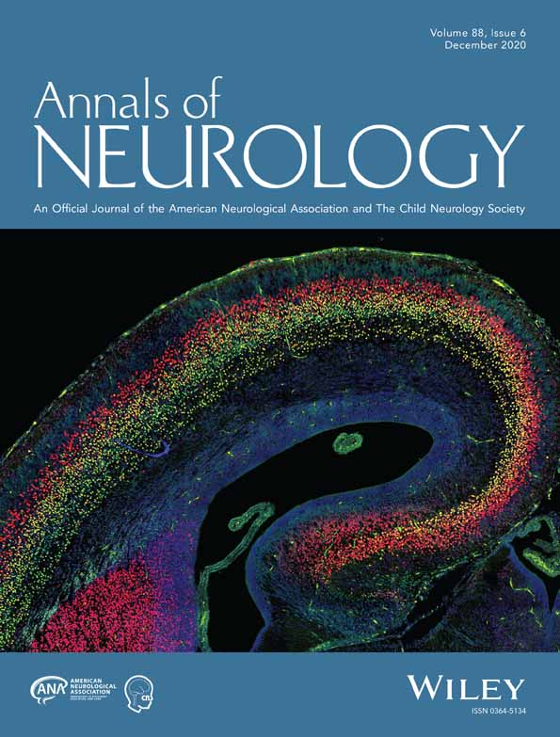
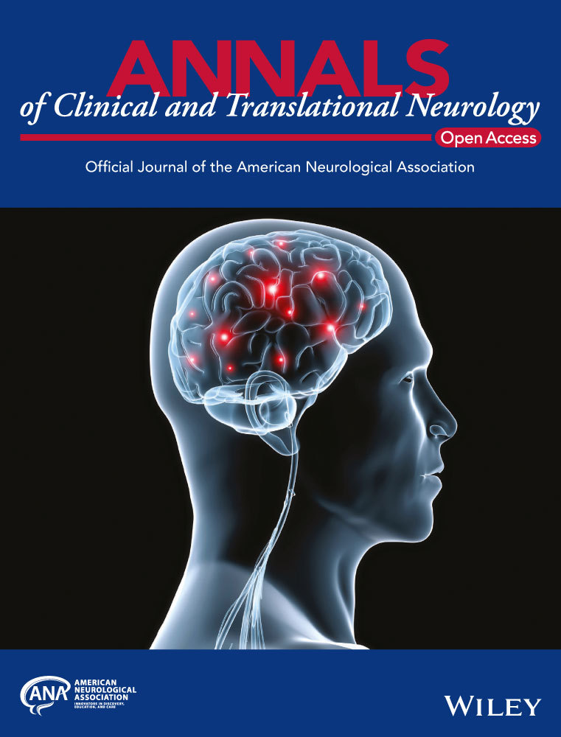
High-Impact Journals
All members receive complimentary access to Annals of Neurology and the online Annals of Clinical and Translational Neurology (ACTN), as well as discounted rates for submitting articles to ACTN.
As one of the most prestigious medical publications in the world, Annals of Neurology publishes high-impact clinical and basic research in neurology and neuroscience.
Annals of Clinical and Translational Neurology is an online-only, open-access journal created to rapidly disseminate high-quality research related to all areas of neurology.

Slide 6
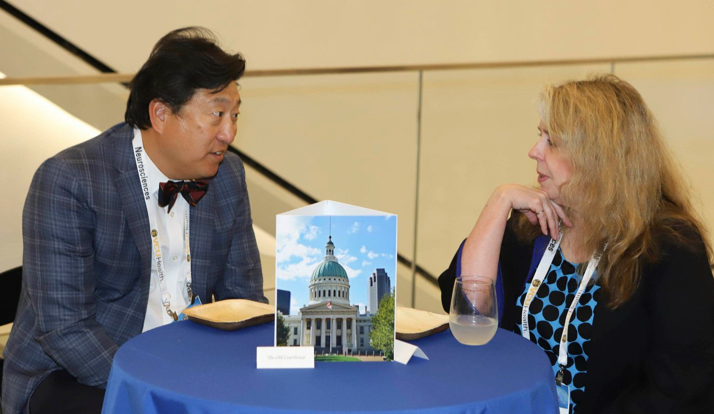


Networking
MentorLink connects ANA members at different career stages with similar research interests to share ideas and receive professional advice. Early career academic neurologists and neuroscientists have the opportunity to serve as mentors as well as senior level professionals.
The ANA Neuro Network is an exclusive online community for ANA academic neurologists and neuroscientists to gather and share questions, comments, and ideas.
Connect with academic neurologists and neuroscientists from other subspecialties, advancing your research and expanding your network using the Member Directory.

Slide 7
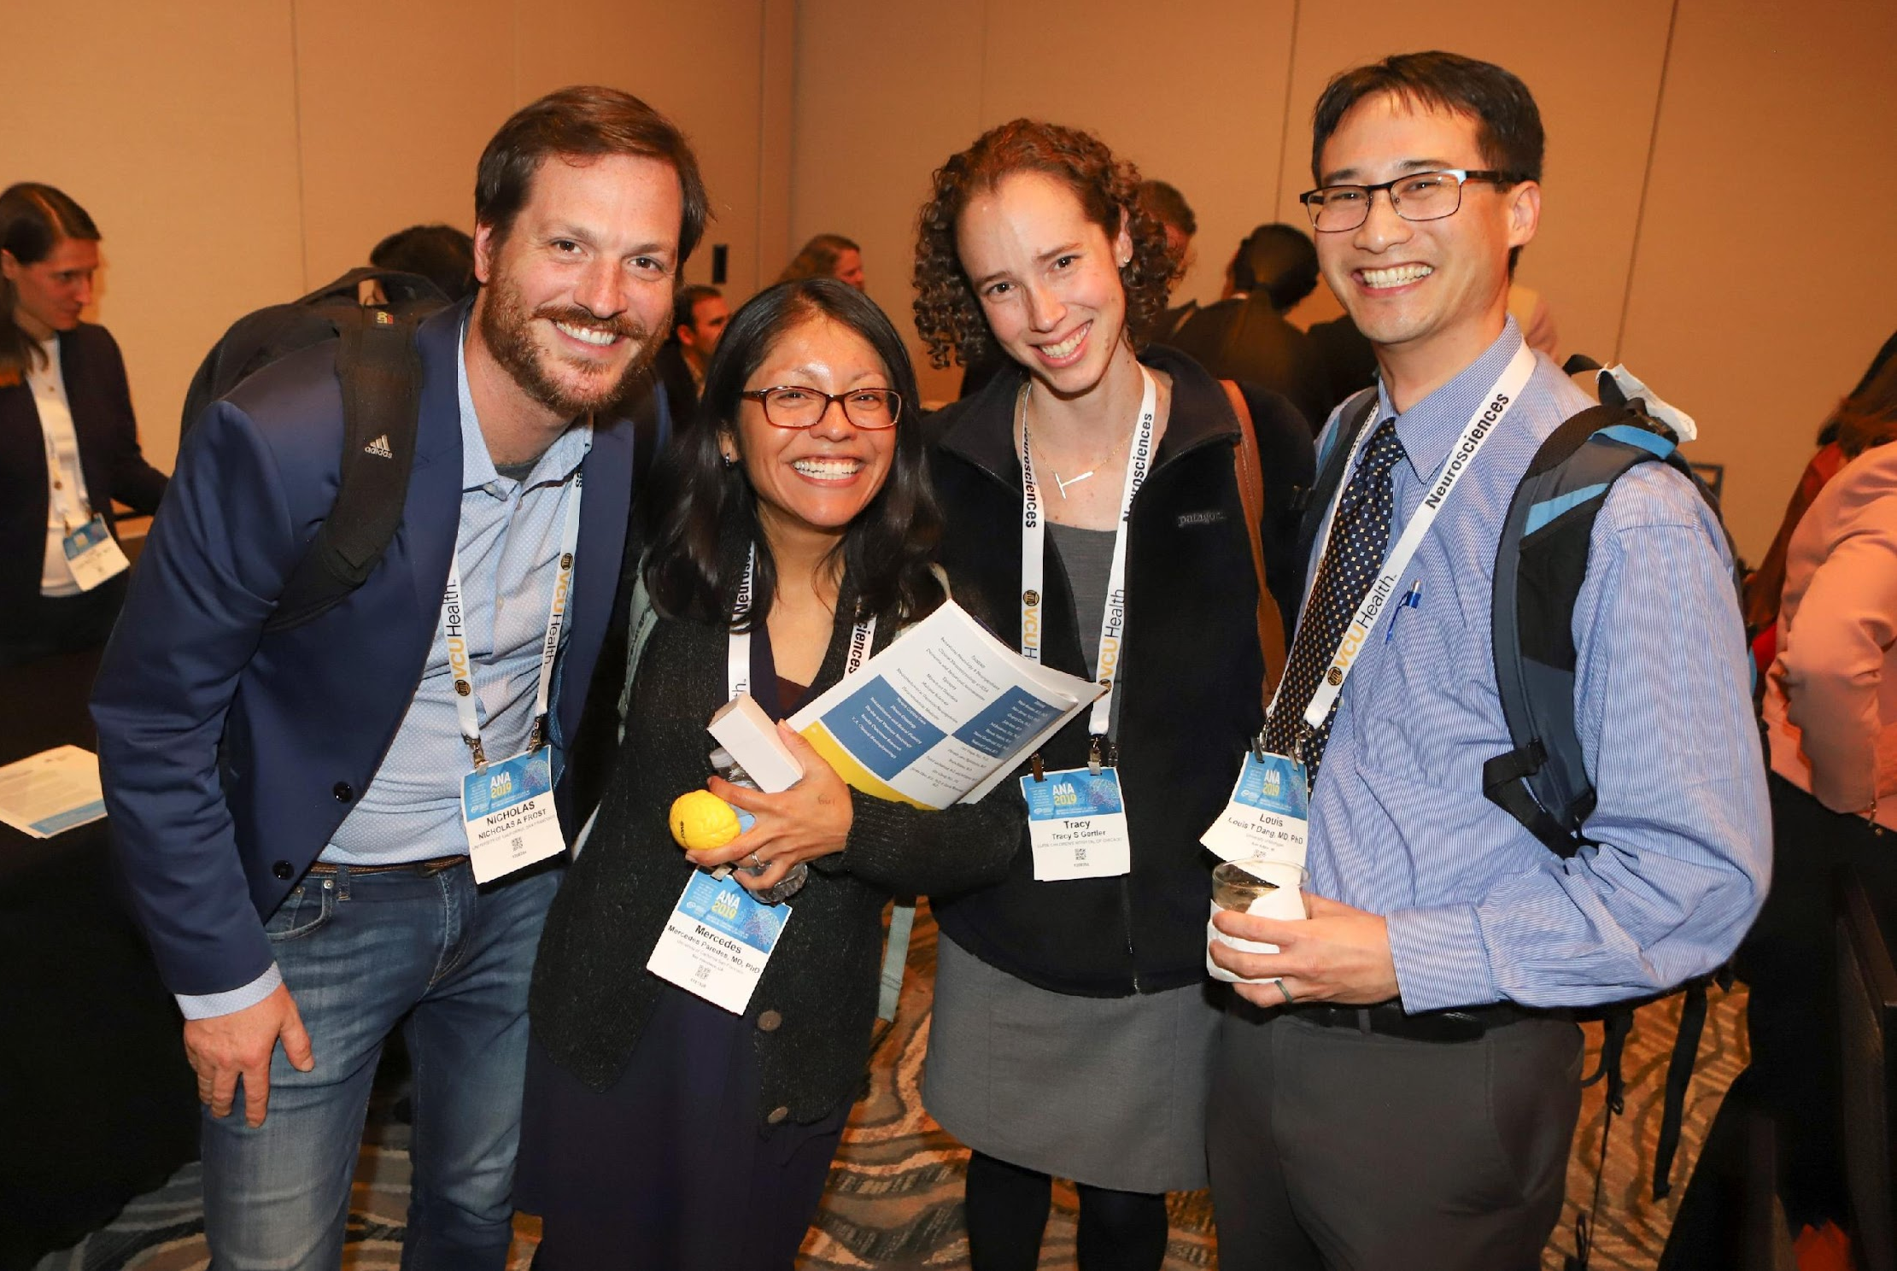
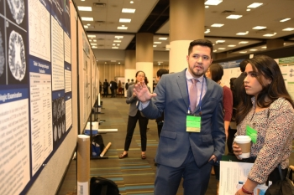
ANA Annual Meeting
Groundbreaking science
Career-advancing networking with thought leaders in neurology
Professional Development Courses
Interactive Workshops
Special Interest Group Sessions
For over 140 years, academic neurologists and neuroscientists have connected over exciting research updates and best practices at the ANA Annual Meeting.

Slide 8
Additional Member Benefits for Students
Making Membership Affordable
$30 annual membership dues
Significantly Reduced Annual Meeting Registration Fees
Encouraging Annual Meeting Participation
Poster Awards
Emerging Scholar Awards
Travel Awards for Poster Presenters
Dependent Care Travel Grant
Junior & Early Career Reception
Professional Development Courses
Career Development
Committee Opportunities

Slide 9
Additional Member Benefits for
Postdoctoral Fellows, Residents & Trainees
Making Membership Affordable
$50 annual membership dues
Significantly Reduced Annual Meeting Registration Fees
Encouraging Annual Meeting Participation
Travel Awards for Poster Presenters
Dependent Care Travel Grant
Junior & Early Career Reception
ANA-AUPN Career Fair
Professional Development Courses
Biennial Translational & Clinical Research Course (TCRC)
Awards
Poster Awards
Emerging Scholar Awards
Career Development
International Outreach Travel Scholarship
Committee Opportunities

Slide 10
Additional Member Benefits for Early Career Members
Awards & Lectureships
Emerging Scholar Awards
The Grass Foundation--ANA Award in Neuroscience
Audrey S. Penn Lectureship
Grants & Scholarship Programs
Travel Awards for Poster Presenters
Dependent Care Travel Grant
International Outreach Travel Scholarship
Career Development
Board and Committee Opportunities
Junior & Early Career Reception at the ANA Annual Meeting
Professional Development Courses at the ANA Annual Meeting
Biennial Translational & Clinical Research Course (TCRC)

Slide 11
Additional Member Benefits for
Associate Professors & Beyond
Awards & Lectureships
Derek Denny-Brown Young Neurological Scholar Award
Distinguished Neurology Teacher Award
George W. Jacoby Award
Raymond D. Adams Lectureship
Soriano Lectureship
Audrey S. Penn Lectureship
Career Development
Board & Committee Opportunities
Professional Development Courses at the ANA Annual Meeting

Slide 12
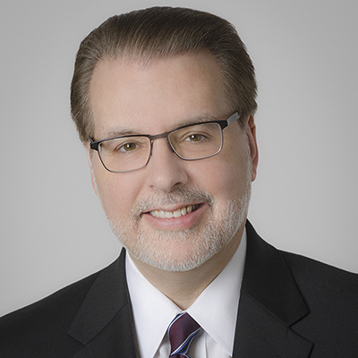
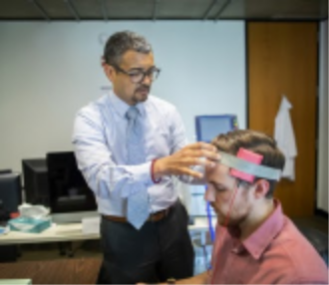
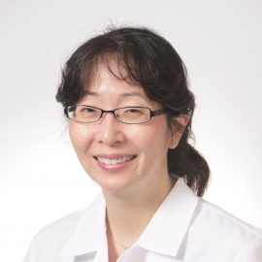
ANA Membership Makes a Difference
“By bringing together all of the researchers from the most prestigious universities around the country, the ANA provides a forum for extended collaboration and the exchange of ideas, and a place where academic neurologists can find like-minded colleagues who are engaged in the same research and the same battles to discover new therapies for neurological disease.”
– Clifton L. Gooch, MD, Board Member, American Neurological Association, Professor and Chair, Neurology, Neuromuscular Medicine, University of South Florida
“It's really been fantastic to be in the ANA. I recall being a medical student, when I was in a laboratory getting my first taste of brain stimulation. My research mentor at the time was being inducted as a fellow of the ANA. I remember going to the meetings and thinking, ‘This is where I want to be when I grow up,’ and I am so excited that it came to fruition.”
– Roy Hamilton, MD, MS
Associate Professor of Neurology
University of Pennsylvania
The ANA has been vital for obtaining quality feedback on my research and developing new collaborations. I really enjoy the yearly meetings because they are interactive and just the right size for networking.”
– Tritia Yamasaki, MD, PhD
Assistant Professor of Neurology
University of Kentucky

Slide 13
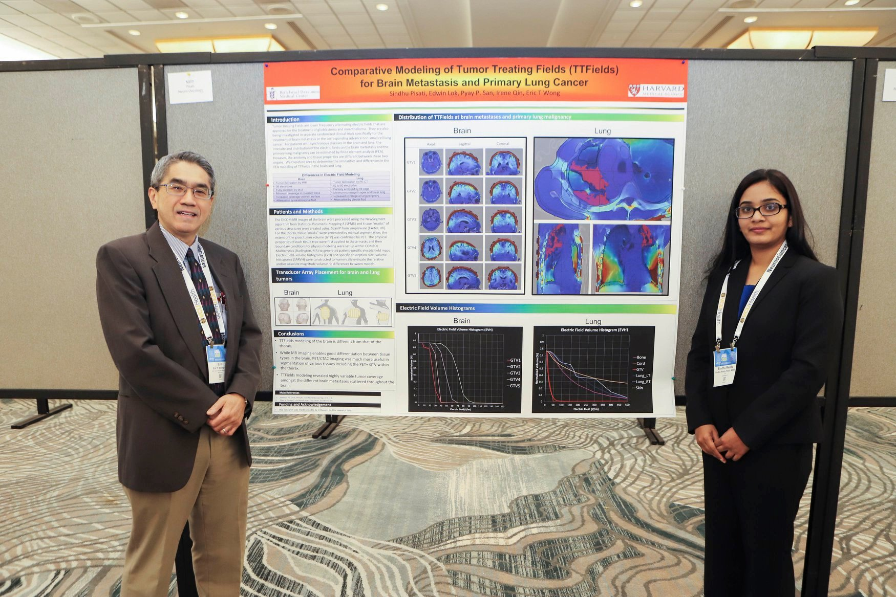
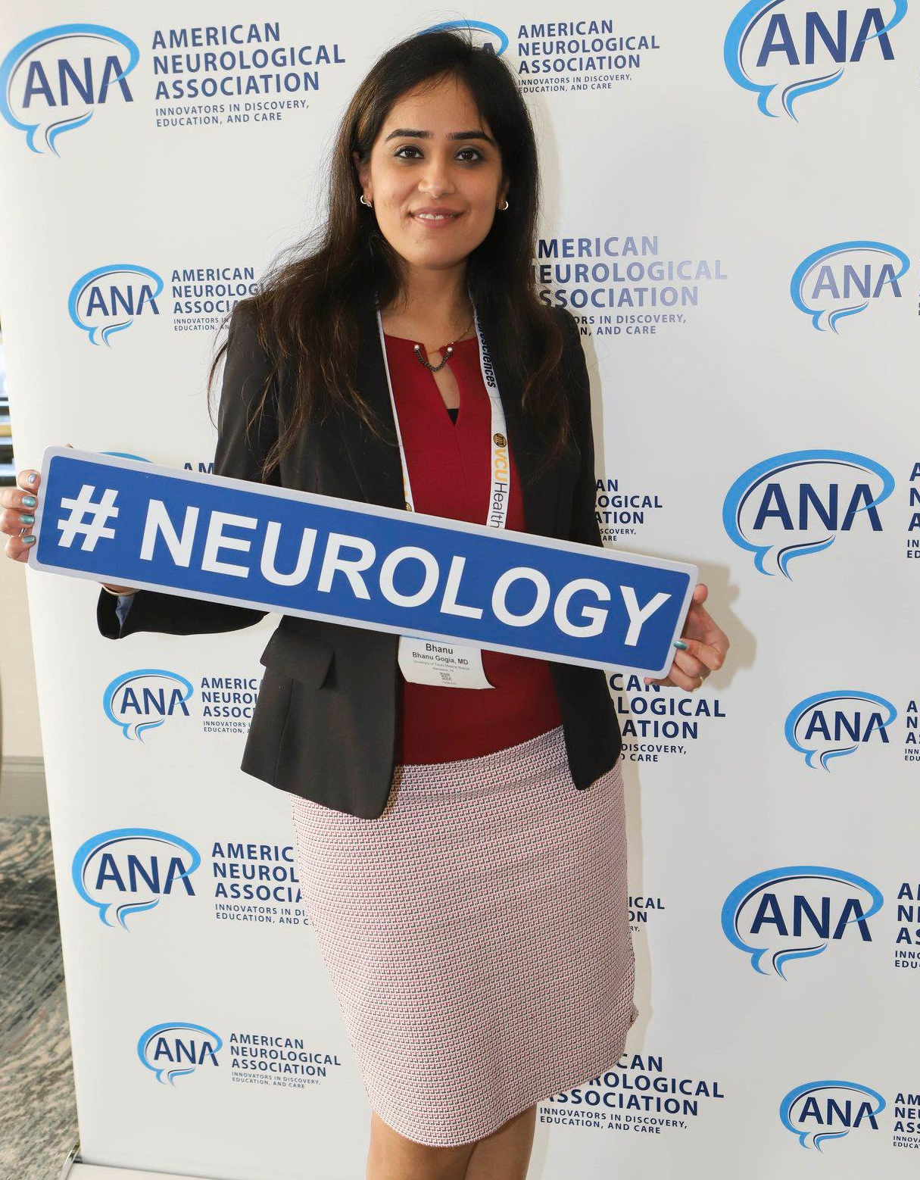
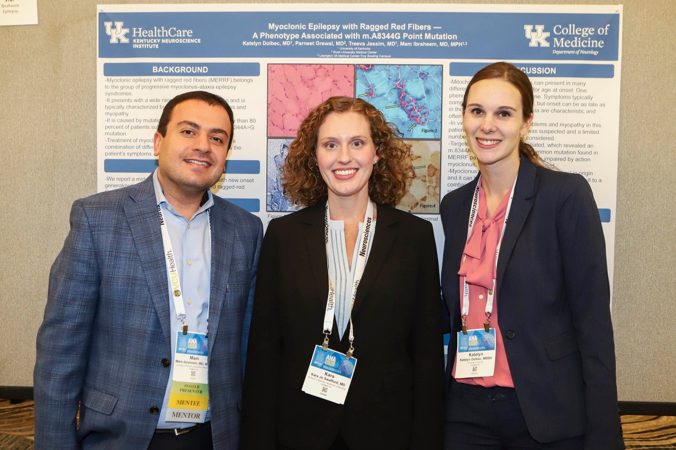
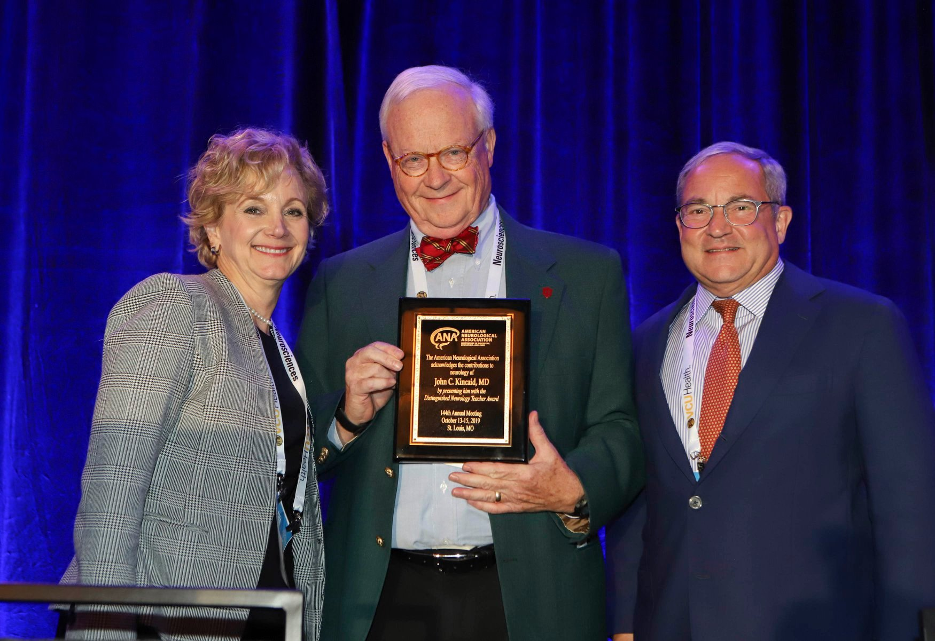

Become a member today!
Visit myana.org to learn more.

